Slide 2
learn Open-Source Software Related To Hadoop.

Slide 3
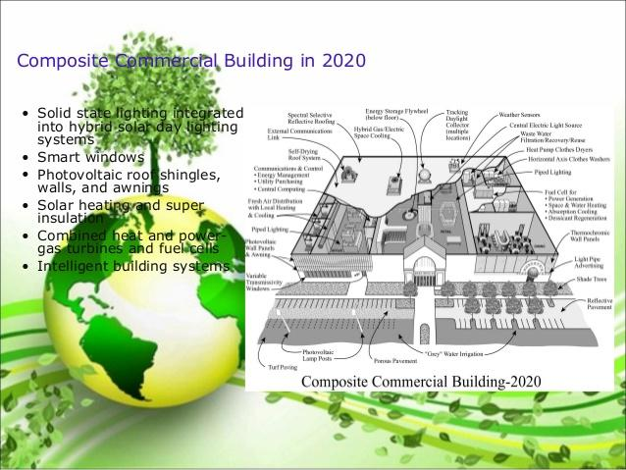
Introduction
Energy efficient & Green Model

Slide 4
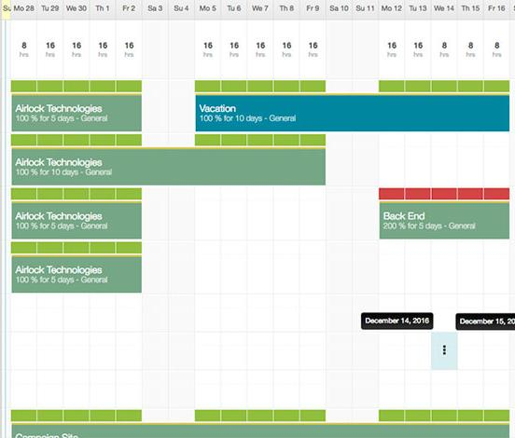
Introduction
Resource Scheduling

Slide 5
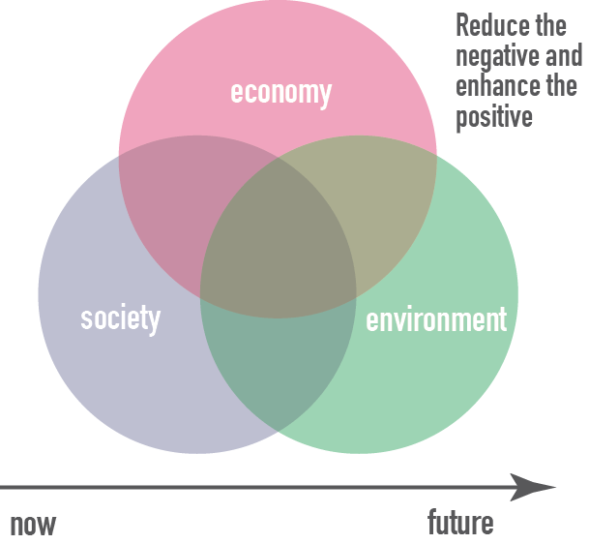

Introduction
Sustainability Issues
Fault Tolerance and Reliability

Slide 6
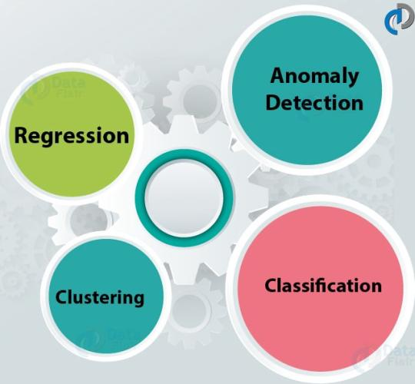

Introduction
Machine Learning Techniques
Graph Analysis

Slide 7

Introduction
Large Scale Recommender System

Slide 8
Introduction
Index structures for big data analytics
Exploratory analytics
Big data management
Scientific computing

Slide 9
Introduction
Index structures for big data analytics
Exploratory analytics
Big data management
Scientific computing

Slide 10
Introduction
Index structures for big data analytics
Exploratory analytics
Big data management
Scientific computing

Slide 11
Introduction
Index structures for big data analytics
Exploratory analytics
Big data management
Scientific computing

Slide 12
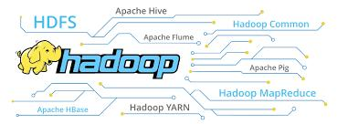
Hadoop
Hadoop is an Open-Source Tool that available in public.
It is a framework that provides too many services like Pig, Impala, Hive, HBase, etc.

Slide 13
Top Hadoop Related Open-Source Tools
Lucene [Java based text search engine]
Eclipse [Popular IDE written in Java]
HBase [Hadoop NoSQL Database]
Hive [Query data engine]
Jaql [Query language for JavaScript]
Pig [Large datasets analyzing platform]
Zookeeper [Centralized configuration service]
Avro [Data serialization system]
UIMA [unstructured analytic framework]
Presto [Distributed SQL query solution]

Slide 14
Lucene(Java Based Text Search Engine)
Lucene is an open source Java based search library. It is very popular and a fast search library. It is used in Java based applications to add document search capability to any kind of application in a very simple and efficient way.

Slide 15
Lucene(Java Based Text Search Engine)
How Search Application works?
Acquire Raw Content
Build the document
Analyze the document
Indexing the document
User Interface for Search
Build Query
Search Query
Render Results

Slide 16
Lucene(Java Based Text Search Engine)
How Search Application works?
Acquire Raw Content
Build the document
Analyze the document
Indexing the document
User Interface for Search
Build Query
Search Query
Render Results

Slide 17
Lucene(Java Based Text Search Engine)
How Search Application works?
Acquire Raw Content
Build the document
Analyze the document
Indexing the document
User Interface for Search
Build Query
Search Query
Render Results

Slide 18
Lucene(Java Based Text Search Engine)
How Search Application works?
Acquire Raw Content
Build the document
Analyze the document
Indexing the document
User Interface for Search
Build Query
Search Query
Render Results

Slide 19
Lucene(Java Based Text Search Engine)
How Search Application works?
Acquire Raw Content
Build the document
Analyze the document
Indexing the document
User Interface for Search
Build Query
Search Query
Render Results

Slide 20
Lucene(Java Based Text Search Engine)
How Search Application works?
Acquire Raw Content
Build the document
Analyze the document
Indexing the document
User Interface for Search
Build Query
Search Query
Render Results

Slide 21
Lucene(Java Based Text Search Engine)
How Search Application works?
Acquire Raw Content
Build the document
Analyze the document
Indexing the document
User Interface for Search
Build Query
Search Query
Render Results.

Slide 22
Lucene(Java Based Text Search Engine)
How Search Application works?
Acquire Raw Content
Build the document
Analyze the document
Indexing the document
User Interface for Search
Build Query
Search Query
Render Results

Slide 23
Lucene(Java Based Text Search Engine)
Apart from these basic operations, a search application can also provide administration user interface and help administrators of the application to control the level of search based on the user profiles. Analytics of search results is another important and advanced aspect of any search application.

Slide 24
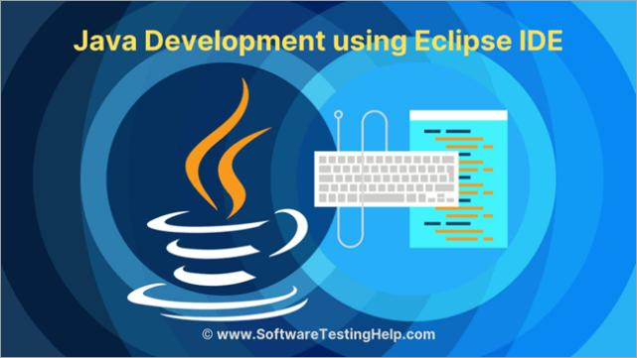
Eclipse [Popular IDE written in Java]
Eclipse is a Java IDE that is one of the 3 biggest and most popular IDE’s in the world. It was written mostly in Java but it can also be used to develop applications in other programming languages apart from Java using plug-ins

Slide 25
Eclipse [Popular IDE written in Java]
PDE (Plugin Development Environment)
Eclipse flaunts powerful tools for the various processes in application development .
Eclipse can also be used to create various mathematical documents with LaTeX
Eclipse can be used on platforms like Linux, macOS, Solaris and Windows.

Slide 26
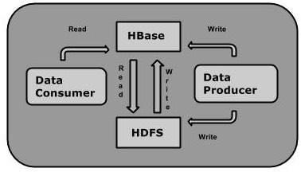
HBase [Hadoop NoSQL Database]
HBase is a data model that is similar to Google’s big table designed to provide quick random access to huge amounts of structured data.

Slide 27
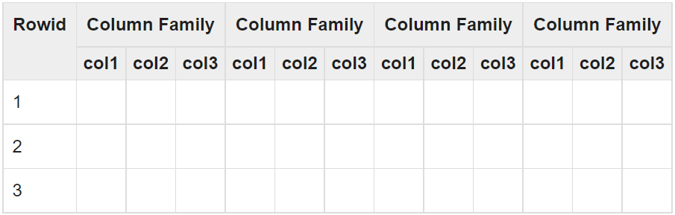
HBase
Storage Mechanism in HBase

Slide 28
Hive [Query data engine]
Hive is a data warehouse infrastructure tool to process structured data in Hadoop. It resides on top of Hadoop to summarize Big Data, and makes querying and analyzing easy.

Slide 29
Hive [Query data engine]
Hive is a data warehouse infrastructure tool to process structured data in Hadoop. It resides on top of Hadoop to summarize Big Data, and makes querying and analyzing easy.

Slide 30
Hive [Query data engine]
Initially Hive was developed by Facebook, later the Apache Software Foundation took it up and developed it further as an open source under the name Apache Hive. It is used by different companies. For example, Amazon uses it in Amazon Elastic MapReduce.

Slide 31
Hive [Query data engine]
Hive is not
  A relational database
  A design for OnLine Transaction Processing (OLTP)
  A language for real-time queries and row-level updates

Slide 32
Features of Hive
It stores schema in a database and processed data into HDFS.
It is designed for OLAP.
It provides SQL type language for querying called HiveQL or HQL.
It is familiar, fast, scalable, and extensible.

Slide 33
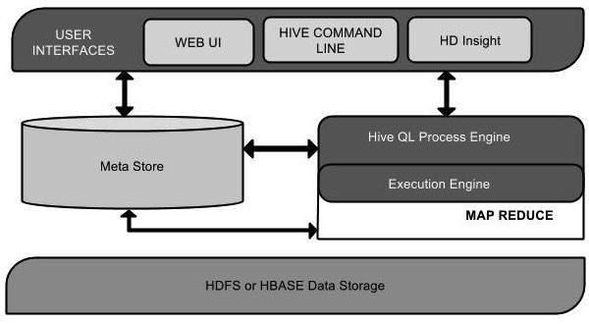
Architecture of Hive

Slide 34
Jaql [Query language for JavaScript]
JAQL is a query language for the JavaScript Object Notation (JSON) data interchange format. As its name implies, a primary use of JAQL is to handle data stored as JSON documents, but JAQL can work on various types of data.

Slide 35
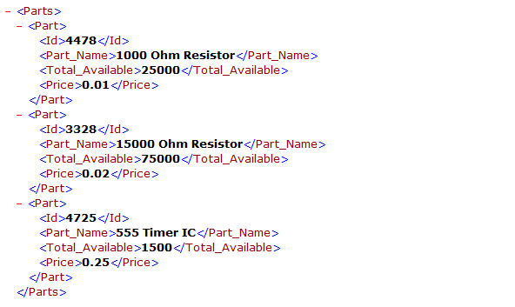
Jaql [Query language for JavaScript]
XML

Slide 36
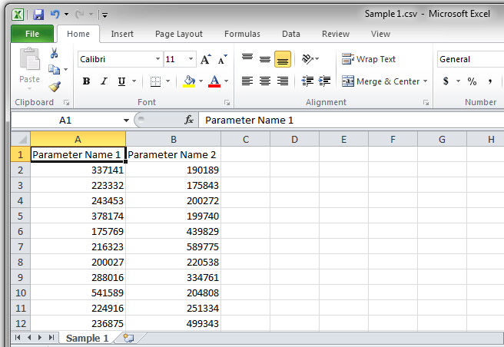
Jaql [Query language for JavaScript]
CSV

Slide 37
Jaql [Query language for JavaScript]
Flat Files
Structured SQL data

Slide 38
Jaql [Query language for JavaScript]
JSON has found wide use in Web and mobile applications, including large-scale big data and enterprise data warehouse applications.
JAQL can run in local mode on individual systems and in cluster mode, in the latter case supporting Hadoop applications.
It automatically generates MapReduce jobs and parallel queries on Hadoop systems.

Slide 39
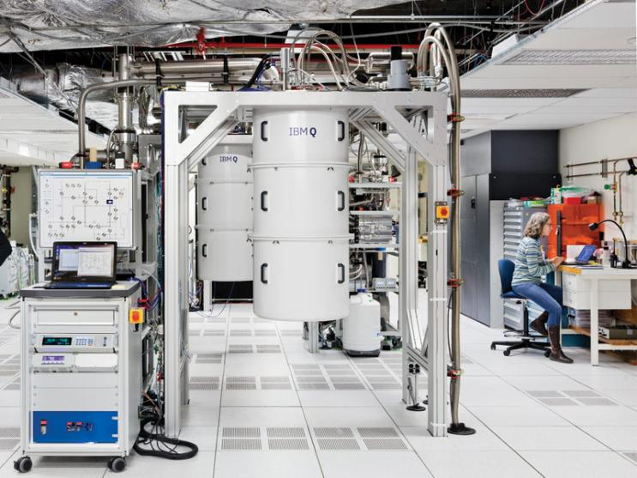
Jaql [Query language for JavaScript]
IBM Research Labs

Slide 40

Jaql [Query language for JavaScript]
Google Code

Slide 41

Jaql [Query language for JavaScript]
Google Code
Apache 2.0 version

Slide 42
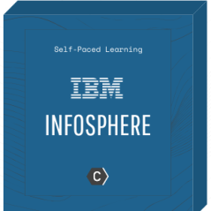
Jaql [Query language for JavaScript]
Google Code
Apache 2.0 version
InfoSphere

Slide 43
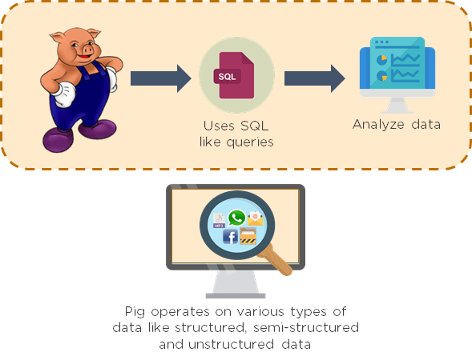
Pig [Large datasets analyzing platform]

Slide 44
Pig [Large datasets analyzing platform]
Why Do We Need Apache Pig?
  Pig Latin
  multi-query approach,
  SQL-like language
  Built-in operators

Slide 45
Pig [Large datasets analyzing platform]
Features of Pig
  Rich set of operators
  Ease of programming
  Optimization opportunities
  Extensibility
  User-defined Functions
  Handles all kinds of data

Slide 46
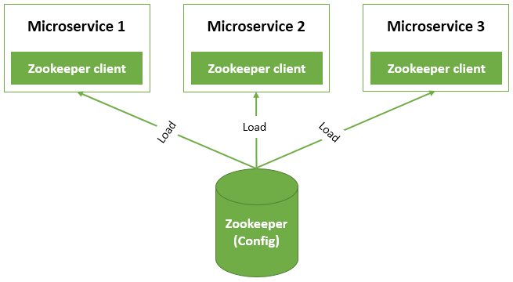
Zookeeper [Centralized configuration service]

Slide 47
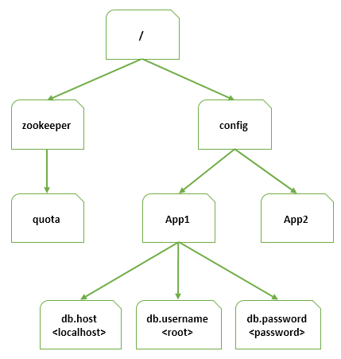
Zookeeper [Centralized configuration service]

Slide 48
Zookeeper [Centralized configuration service]
This is a simplified version of how we are going to setup Zookeeper.
Zookeeper stores data in a tree of ZNodes similar to Linux file system structure, a ZNode may contain another ZNodes or may have a value.
App1 and App2 are sharing data from / and config znodes.
However db.host, db.username and db.password are specific to App1.

Slide 49

Avro [Data serialization system]
Doug Cutting

Slide 50
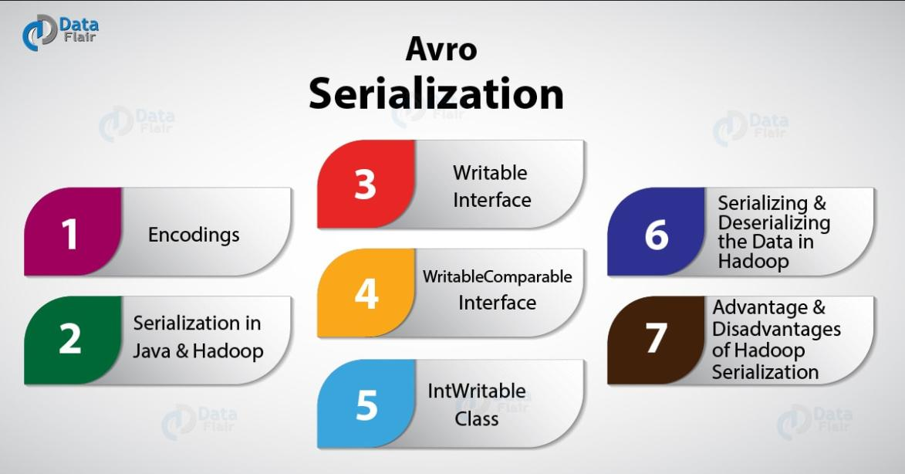
Avro [Data serialization system]

Slide 51
Avro [Data serialization system]
Apache Avro is a language-neutral data serialization system. It was developed by Doug Cutting, the father of Hadoop. Since Hadoop writable classes lack language portability, Avro becomes quite helpful, as it deals with data formats that can be processed by multiple languages. Avro is a preferred tool to serialize data in Hadoop.

Slide 52
Avro [Data serialization system]
Avro has a schema-based system. A language-independent schema is associated with its read and write operations. Avro serializes the data which has a built-in schema. Avro serializes the data into a compact binary format, which can be deserialized by any application.

Slide 53
Avro [Data serialization system]
Avro uses JSON format to declare the data structures. Presently, it supports languages such as Java, C, C++, C#, Python, and Ruby.

Slide 54
Avro [Data serialization system]
Features of AVRO
  language-neutral
  processed by many languages
  compressible and splittable.
  rich data structures
  Avro schemas defined in JSON
  self-describing file named Avro Data File
  Remote Procedure Calls (RPCs).

Slide 55
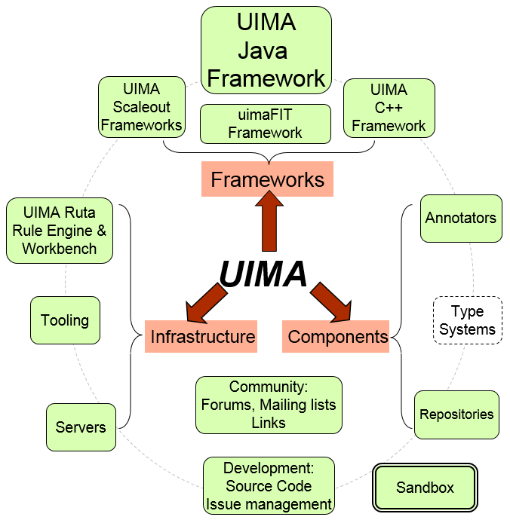
UIMA [unstructured analytic framework]

Slide 56
UIMA [unstructured analytic framework]
Unstructured Information Management applications are software systems that analyze large volumes of unstructured information in order to discover knowledge that is relevant to an end user. An example UIM application might ingest plain text and identify entities, such as persons, places, organizations; or relations, such as works-for or located-at.

Slide 57

Presto [Distributed SQL query solution]
Presto (or PrestoDB) is an open source, distributed SQL query engine, designed from the ground up for fast analytic queries against data of any size.

Slide 58

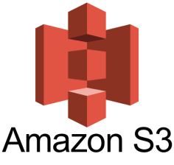

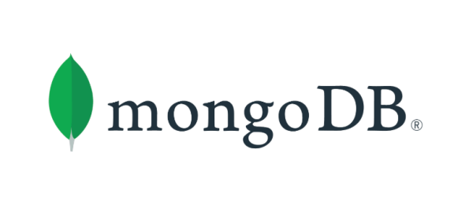
Presto [Distributed SQL query solution]

Slide 59

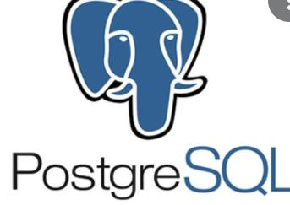

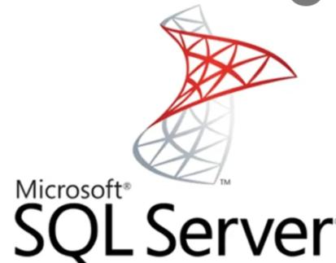

Presto [Distributed SQL query solution]

